Slide 1

Shortest Path in Graphs: Dijkstra Algorithm
MARCUS, CLARA, GUSTAVO E NICOLE

Slide 2
Dijkstra Algorithm
Motivation: we want to find the shortest path between two nodes in a Graph
Algorithm: Dijkstra Algorithm for Shortest Path in Graphs

Slide 3
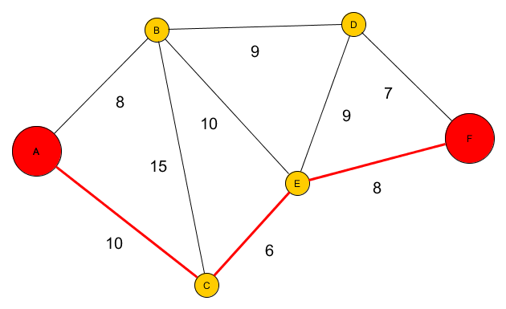
Dijkstra Algorithm
Dijkstra Algorithm for Shortest Path in Graphs is a greedy algorithm that finds the shortest path between two vertices in a weighted Graph given the source and target vertices, and the cost between the vertices of the Graph.

Slide 4
Definitions for Dijkstra Algorithm
Vertex: A “point” with his own value in the Graph
Path: how to go by one vertex to another one
Weighted: a Graph where all the edges have a label (weight) associated to him
Neighbor: vertices that are united with another vertex by a edge
Infinity: LONG_MAX in C
Undefined: -1 in C
Previous: vertex before another vertex in the path

Slide 5
Dijkstra Algorithm: Pseudo Code
Function Dijkstra(Graph, source)
distance[source] = 0
for each vertex v in Graph
if v != source
distance[v] = infinity
previous[v] = undefined
add v to Q
while Q is not empty
u = vertex in Q with min distance[u]
remove u from Q
for each neighbor v of u
alt = distance[u] + length(u, v)
if alt < distance[v]
distance[v] = alt
previous[v] = u
return distance[], previous[]

Slide 6
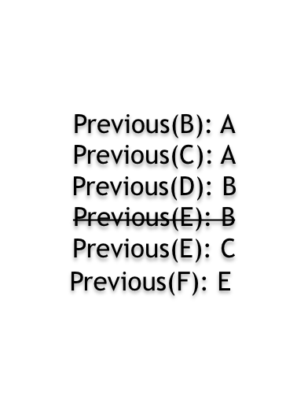
Dijkstra Algorithm in action

Slide 7
Back to motivation
We successfully found the shortest path between two vertices in a Graph

